Slide 1
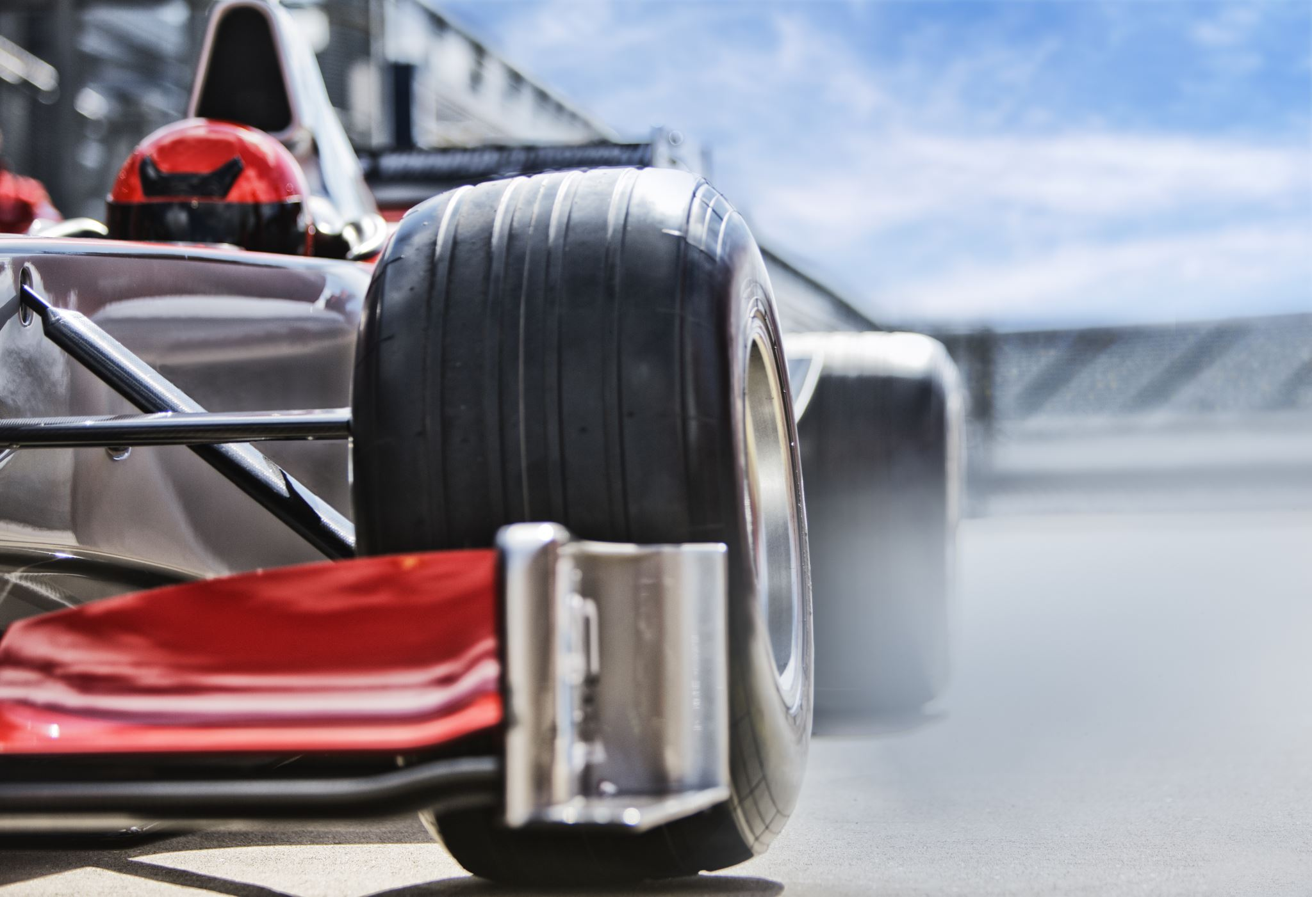
Formula 1 Championship Prediction
Tanmay Ambegaokar
Parv Bhargava
Vishal Bakshi
Richik Ghosh

Slide 2

MOTIVATION
Data Driven Analysis
Predictive Analytics for Outcomes
Leveraging Machine learning Algorithms
Lastly, we all are F1 Geeks!

Slide 3
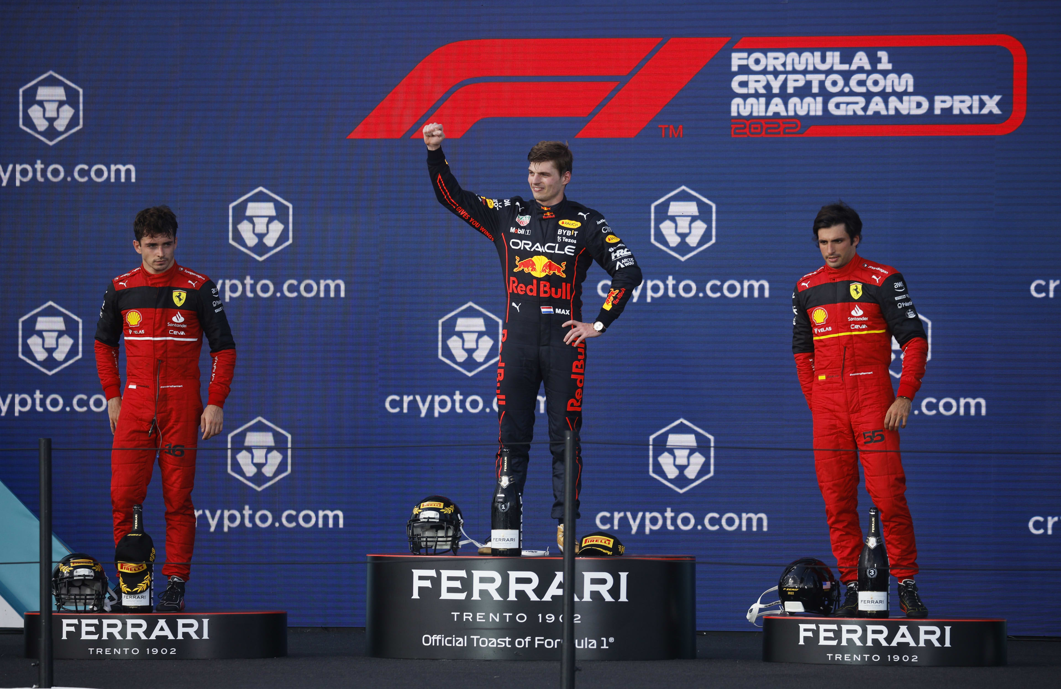
F1 FOR DUMMIES!
Points System in Formula 1:
23 races in 2023.
10 Teams knows as Constructors each with two drivers. So, total 20 drivers.
Points awarded to drivers based on finishing positions in each race.
Top 10 finishers earn points: 25, 18, 15, 12, 10, 8, 6, 4, 2, 1 respectively.
Additional points for fastest lap (if the driver finishes in the top 10): 1 point.
Points contribute to both Drivers' and Constructors' Championships.

Slide 4

SMART QUESTIONS
Can we do lap time analysis using EDA?
Utilizing supervised learning techniques, can we predict the final points earned by a driver?

Slide 5
DATASET OVERVIEW
Unclean Data
14 CSV files
Each inter-related with a primary key
Contains unnecessary columns and NA values
Files have data from 1950-2023
Gives information about race, results, drivers, qualifying time, pit stops, lap times, constructors, and status
Clean Data
Merged Data with relevant info
Converted time and date objects to str type
Keep only relevant columns needed for EDA and modelling.
Remove NA values
Handle all kinds of data types
Merge datasets

Slide 6
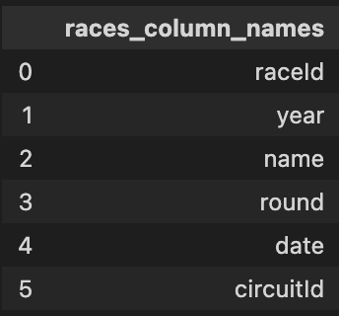
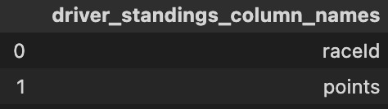
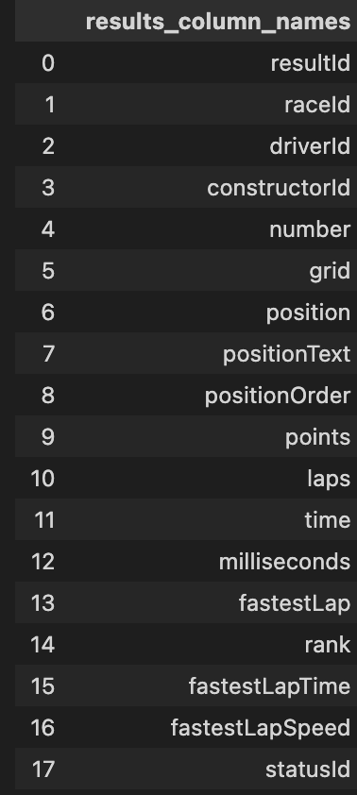
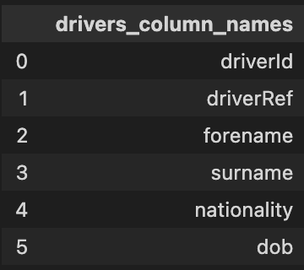
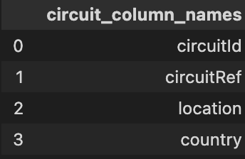
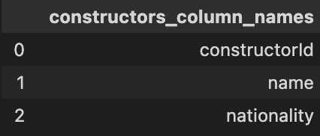
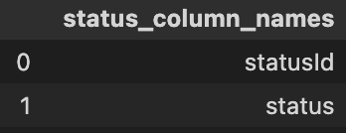
JOINING PROCESS

Slide 7
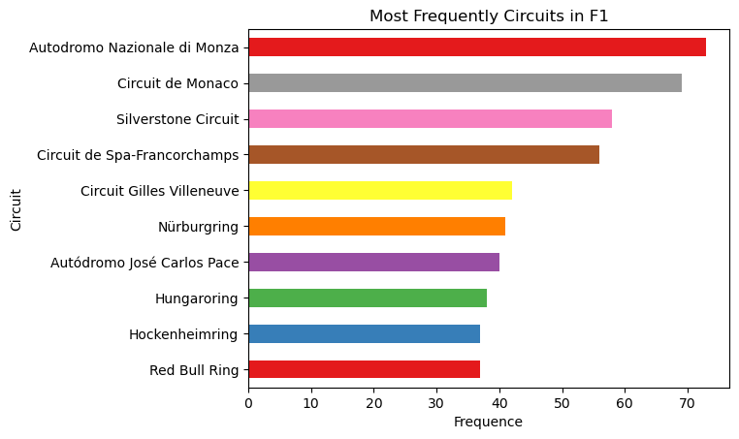
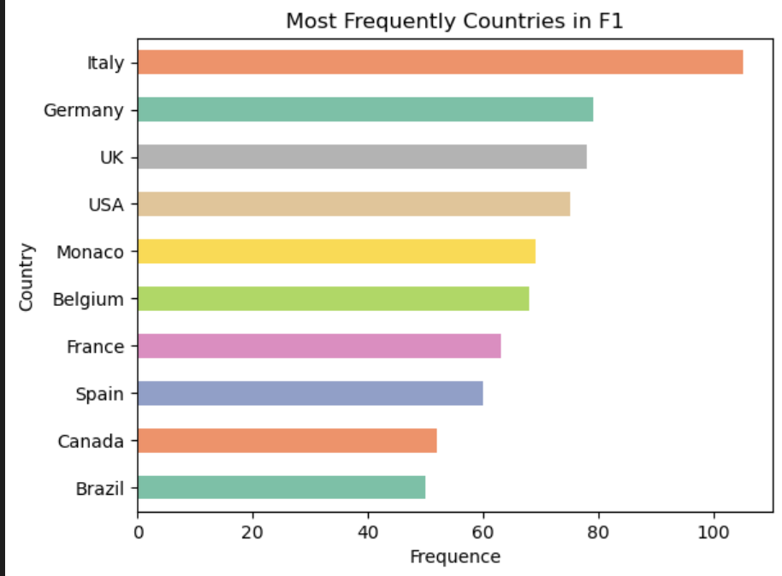
Data Visualization
Antodromo Nazionale di Monza is the circuit that has been driven most frequently which is depicted by dark red color.
Most races have occurred in Italy.

Slide 8
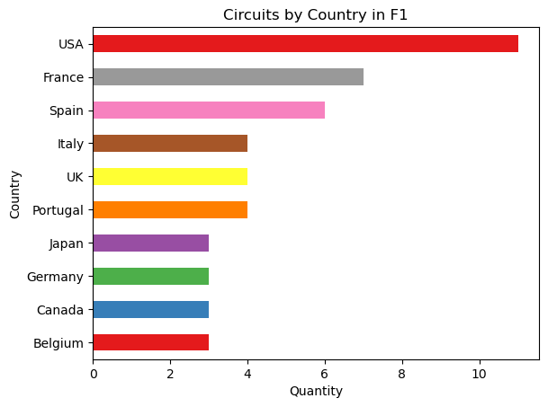
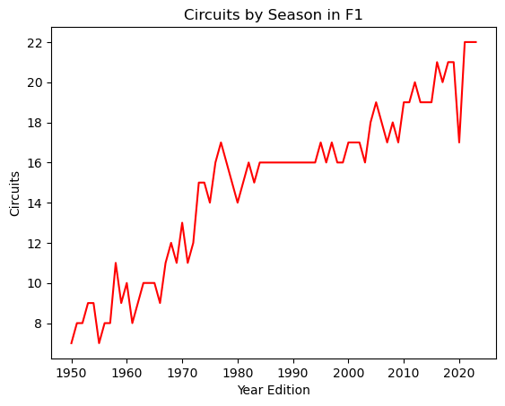
Plot on Circuits
USA has the highest number of circuits.
Observing the line plot, it is evident that the number of circuits has consistently risen each year. The most notable surge occurred between 1970 and 1980, with the count increasing from 12 to 16 circuits.
We also see a steep decrease in 2020 because of the pandemic.

Slide 9
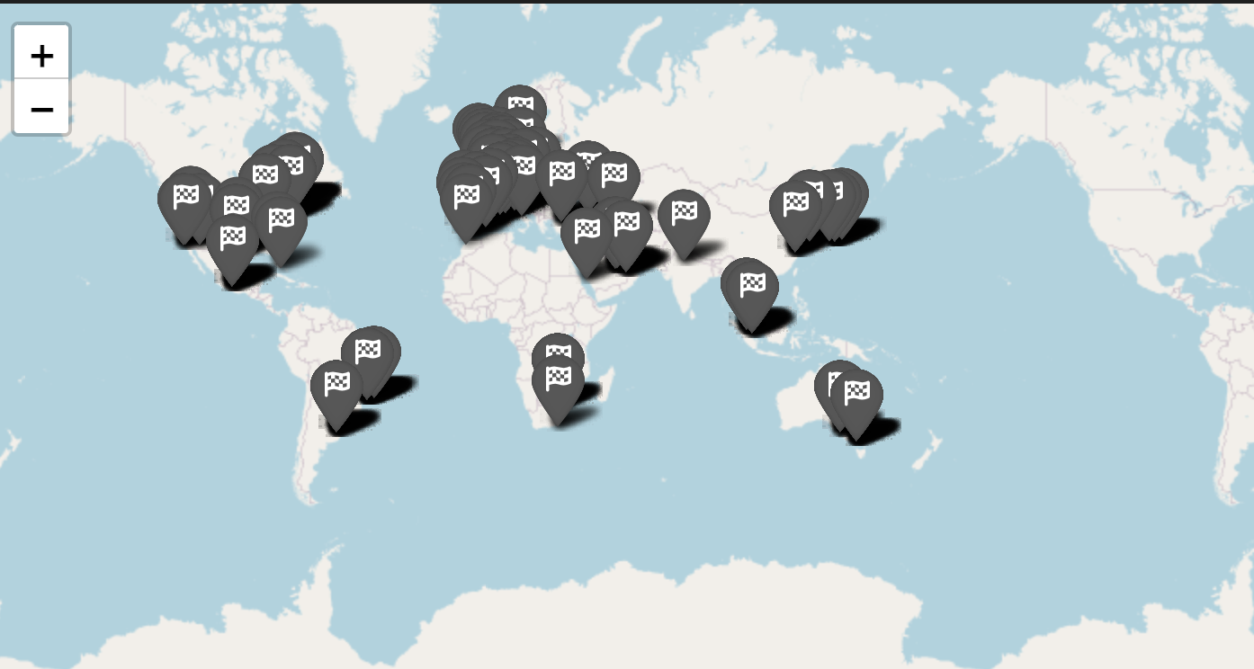
Locations where races has been conducted
Geo Spatial plotting

Slide 10
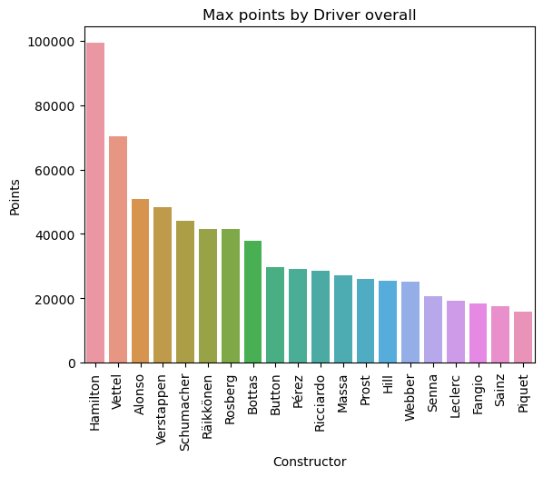
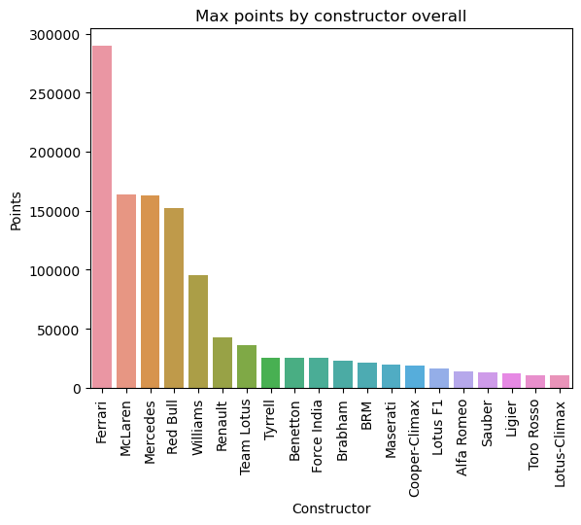
Point Distribution
Hamilton has accumulated the highest number of points.
Ferrari, with the highest points, emerges as the leading constructor, surpassing McLaren by nearly twice the points.

Slide 11
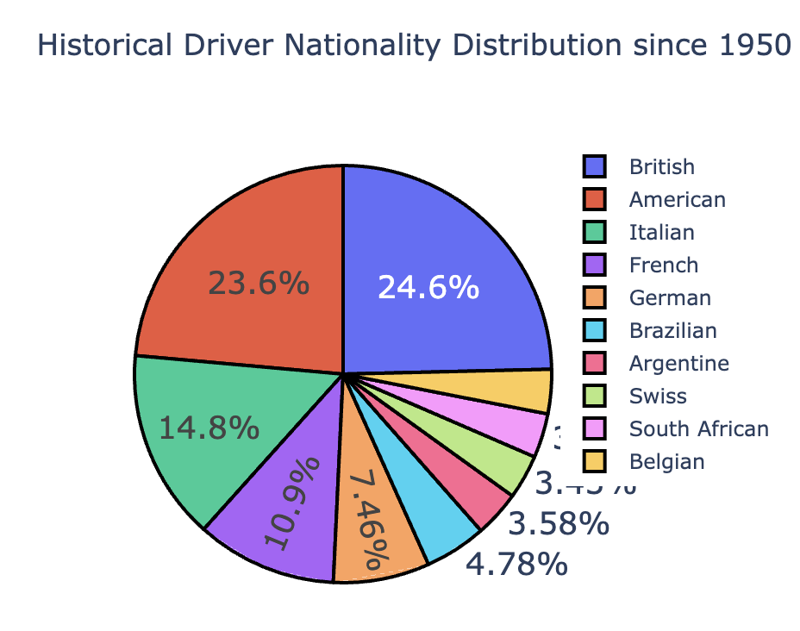
Driver Proportion Distribution Per Country
Almost 50% drivers are Britishers and Americans.
Can you guess the name of the only Indian driver?

Slide 12
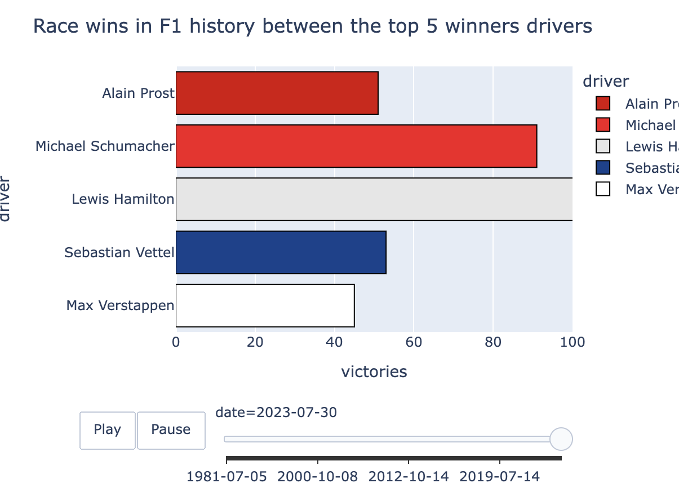
F1 Race Winner Distribution
This plot illustrates the drivers with most wins.
Lewis Hamilton has over 100 race wins!

Slide 13
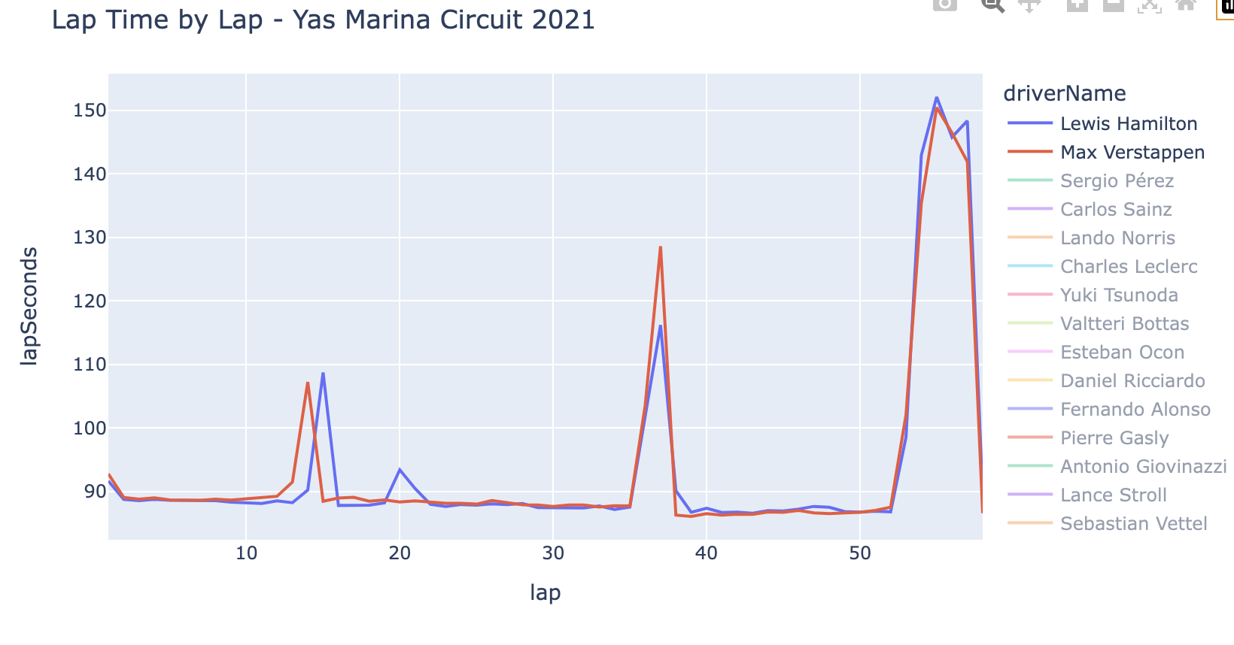
Lap Time Analysis
We can compare the lap times of any driver in any race.
Here, we are comparing the lap times of Hamilton and Verstappen.
The two small spikes tell us when the drivers took a pit stop.
The big spike tells us that a safety car had been deployed.

Slide 14
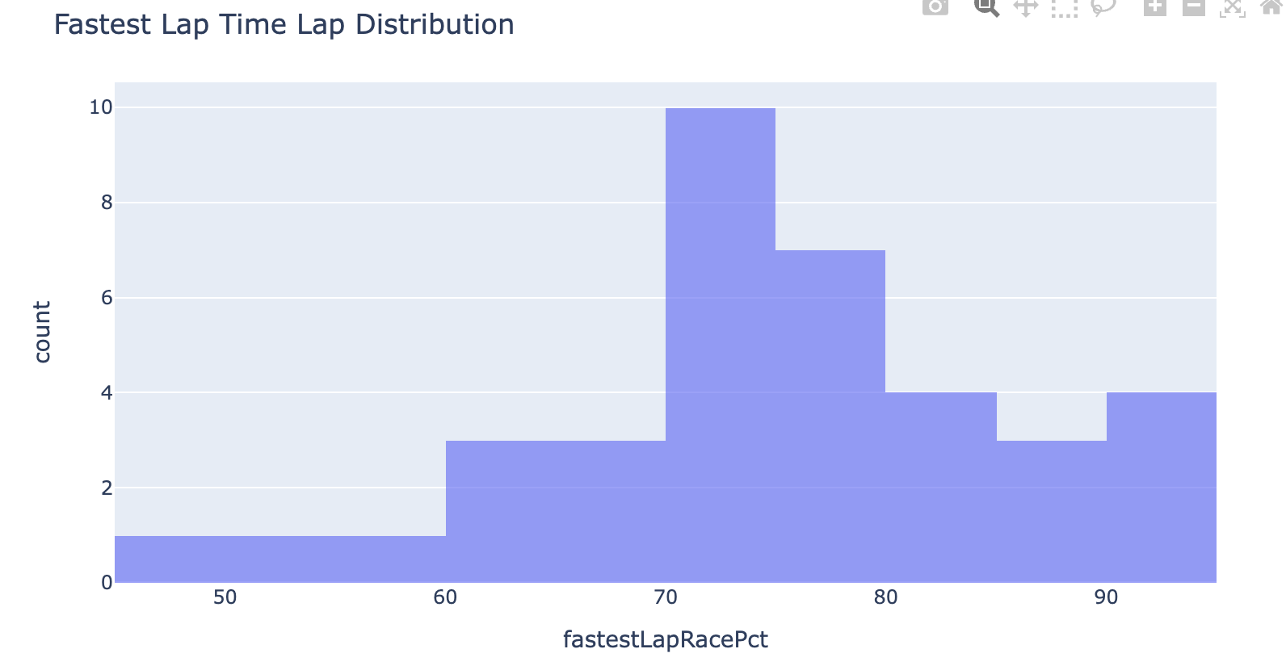
Lap Time Analysis
The graph tells us when in the race a driver goes the fastest.
The fastest lap typically comes after 70-80% the race is over.
Possible reason could be less fuel weight, so lighter car or different strategy to get the extra point.

Slide 15
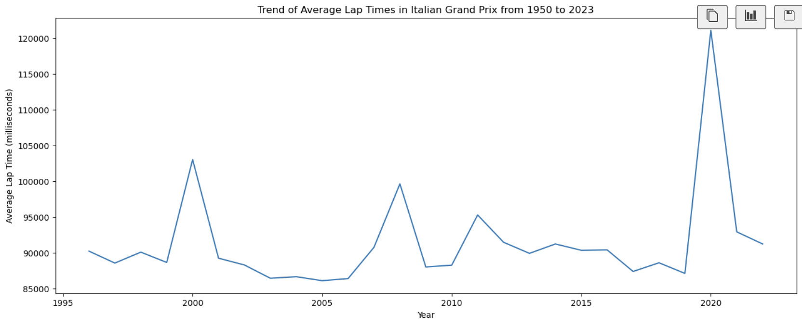
Lap Time Analysis
Generally, we can see that the average lap time has decreased from 1990 to 2023.
The occasional rises are due to rule changes in the design implementation of the car.

Slide 16

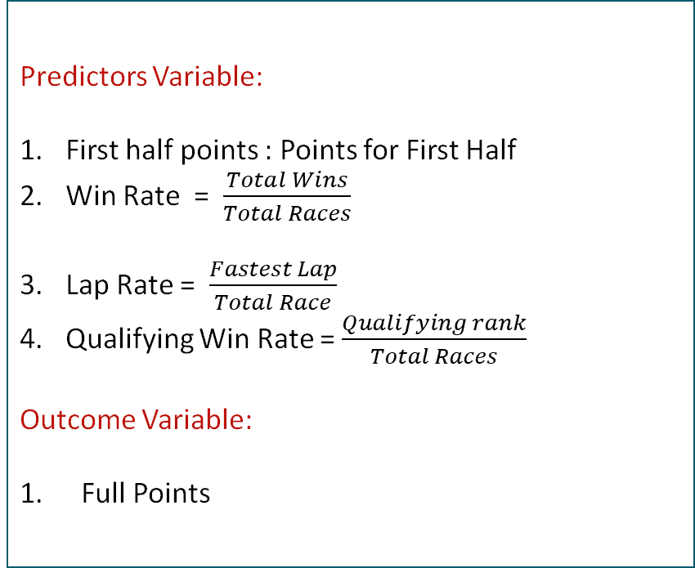
Data Modelling
Predictors Variable:
First half points : Points for First Half
Win Rate = $\frac{Total Wins}{Total Races}$
Lap Rate = $\frac{Fastest Lap}{Total Race}$
Qualifying Win Rate = $\frac{Qualifying rank}{Total Races}$
Outcome Variable:
Full Points

Slide 17
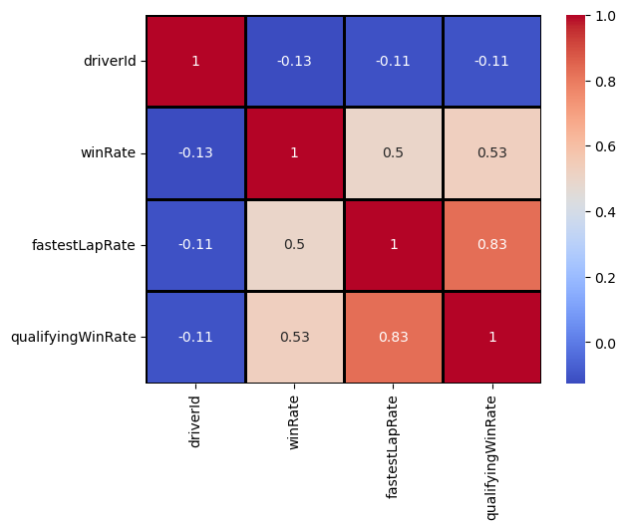
CORRELATION MATRIX
Win rate shows a strong positive correlation with fastest lap and qualifying.
We also checked for VIF which was below 4 for all the features.

Slide 18
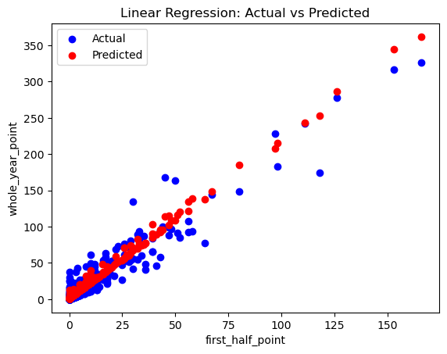
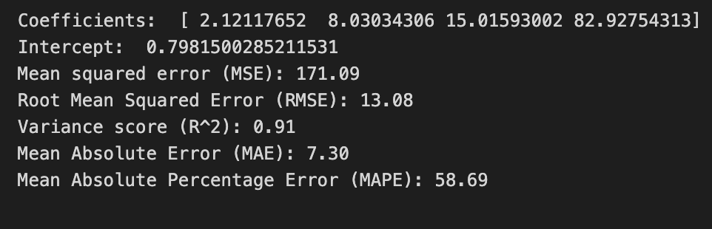
Linear Regression Model
The given depiction represents a model of multiple linear regression. The forecasted instances are illustrated by the red line, while the actual data points are visually represented as individual points on the graph.

Slide 19
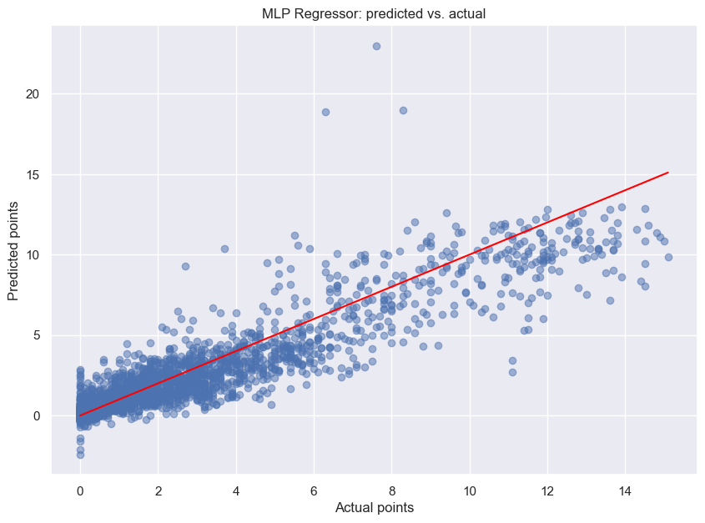
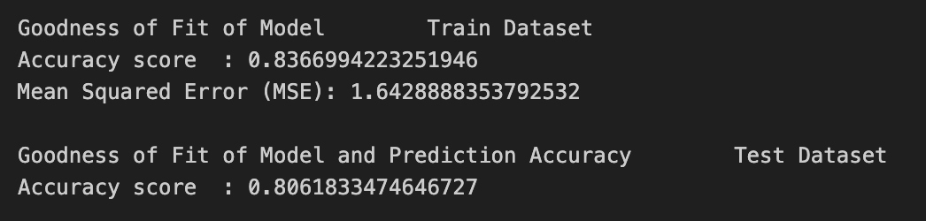
MLP Regressor
Our model, which incorporates hidden layers with 30, 20, 30, 10, 20, and 40 nodes respectively, has been trained over 300 epochs. The observed high train and test accuracies indicate that the model is an good fit.

Slide 20
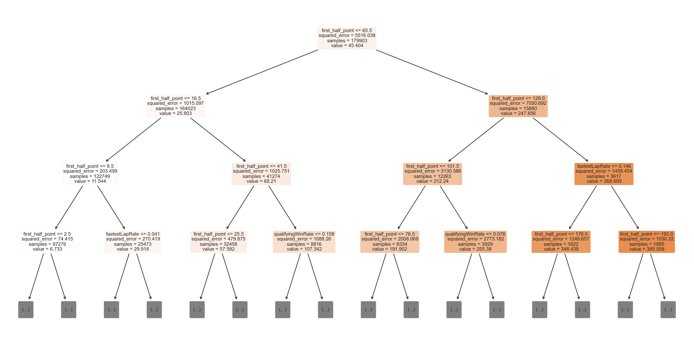
Regression Tree

Slide 21
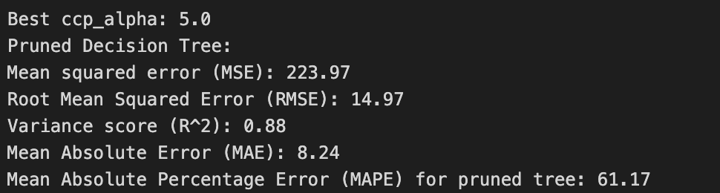
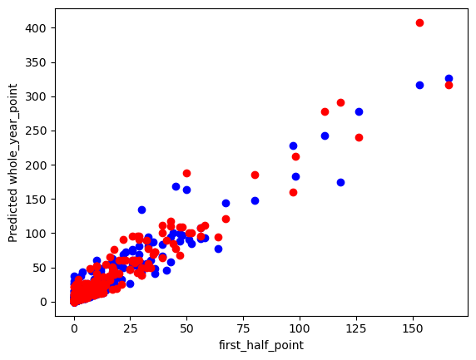
Regression Tree
The most important features are first half points and qualifying win rate.
Here, we have pruned the tree as the model started to overfit the data.

Slide 22
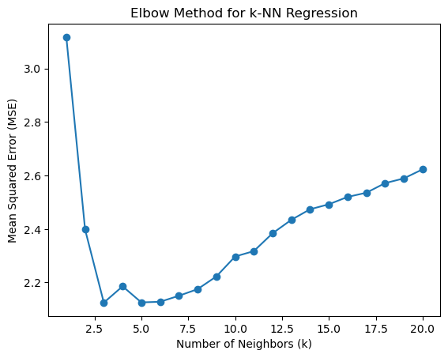
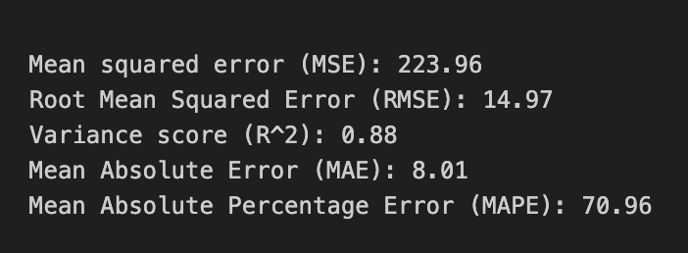
KNN Model
From the elbow method, the least MSE can be obtained with K=5

Slide 23
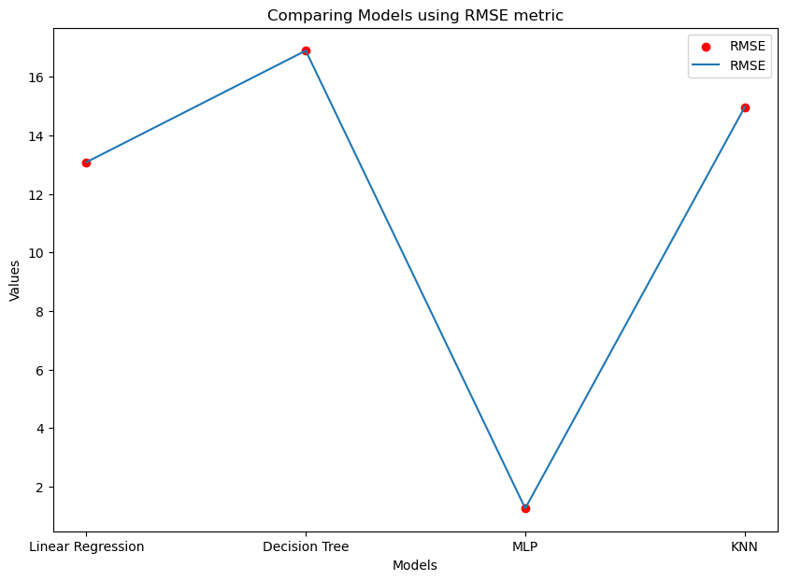
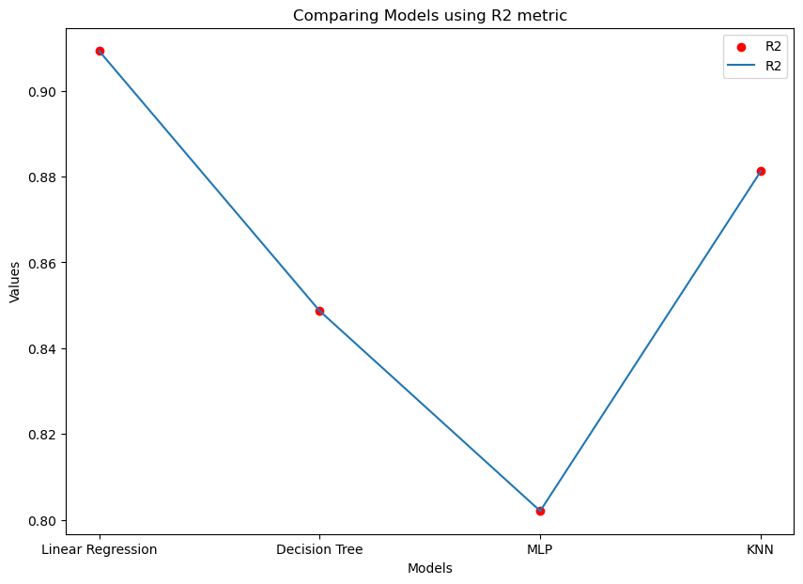
COMPARITIVE SUMMARY

Slide 24
Summary
Lap time decreased over time.
Fastest Lap occurs after 70% of the race is over.
Linear Model gave the best R2 score.
MLP regressor gave the least RMSE score.
While modelling we observed that due to introduction of new features, we might need to further tune the models for better performance metrics.

Slide 25
THANK YOU

